Slide 1
Introduction to Computer Science
(CSC 101)
Week 8
Practice

Slide 2
Microsoft Access 2016

Slide 3
Introduction
MS Access is a relational database management system (RDBMS)
MS FoxPro
“Industrial-strength” RDBMS include
Oracle
Other PC-based RDMBS include:
Borland dBase
MS SQL Server
IBM DB2
Informix

Slide 4
Creating a database
In Access 2016, the process of creating a new database is easy.
You can create a database using one of the many available templates (ready-to-use databases that contain all of the tables, queries, forms, and reports needed for performing specific tasks)
or by creating a new blank database.

Slide 5
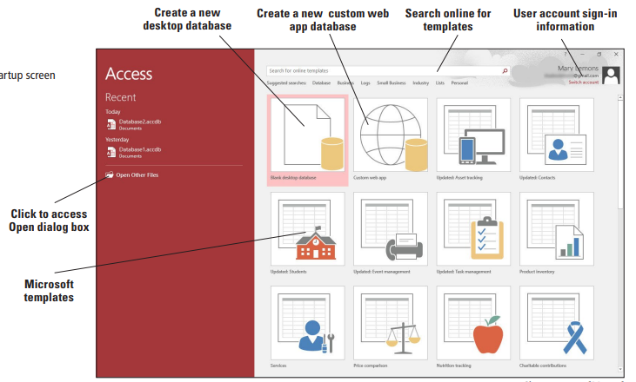
Getting Started

Slide 6
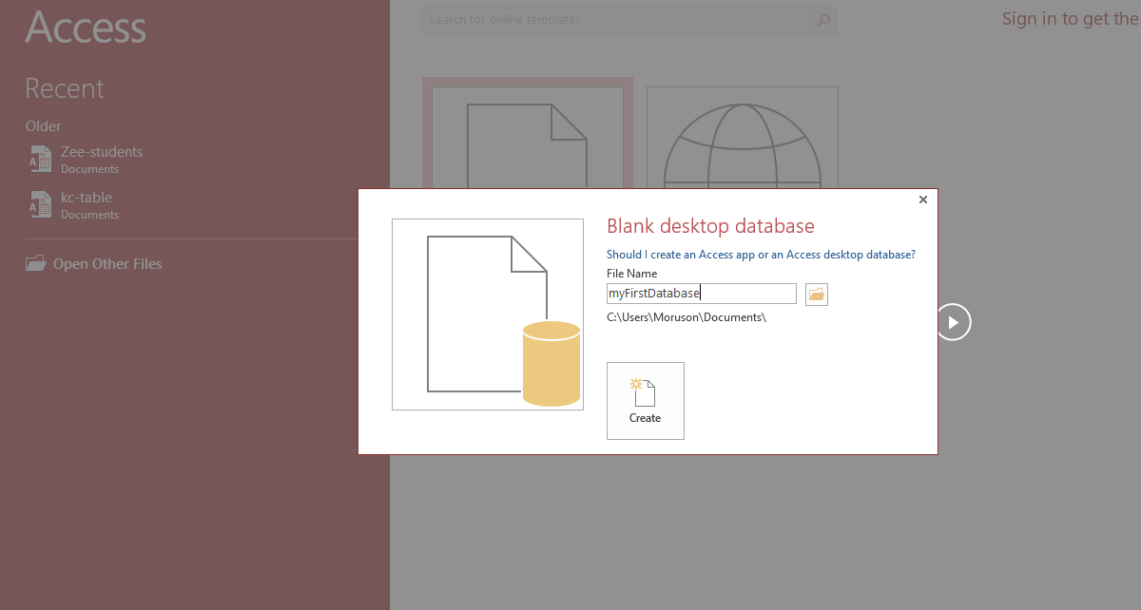
Creating a blank database

Slide 7
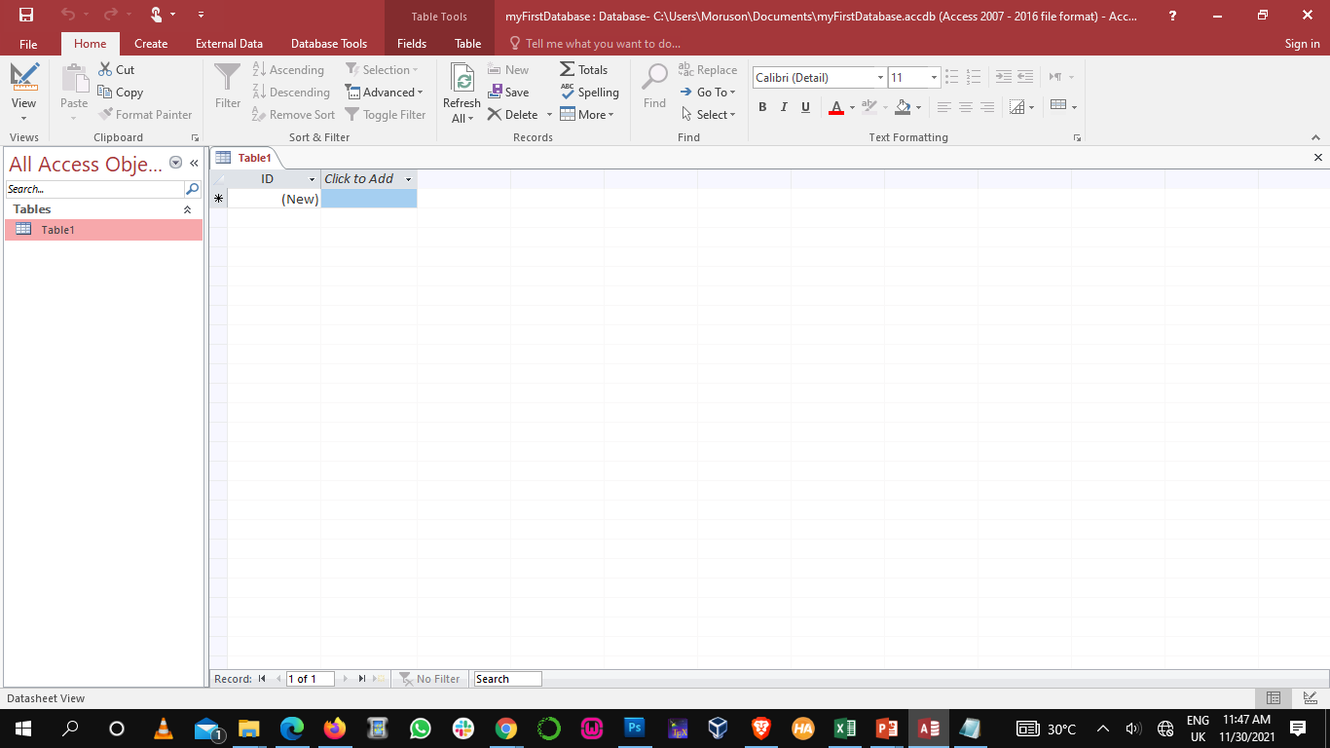
Creating a blank database
Fields
Records

Slide 8
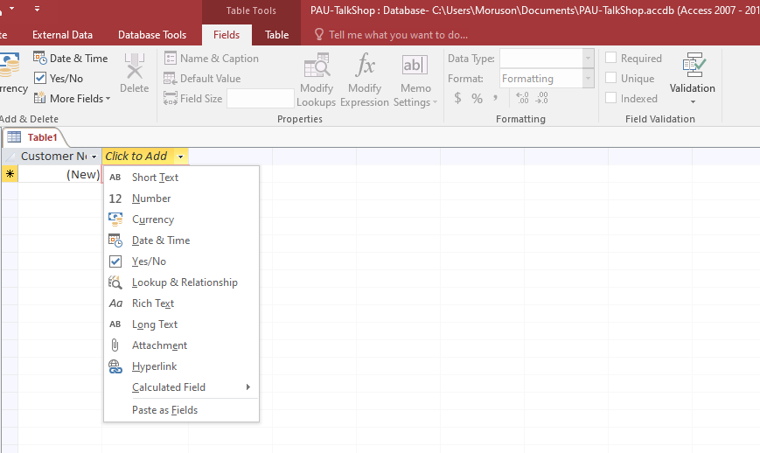
Creating a blank database
Field Data Type

Slide 9
MS Access Functionality
Tables
Reports
Store Data
Queries
Manipulate Data
Provides information from database to users in easy-to-understand format.
Forms
Make data entry and display easier

Slide 10
Characteristics of a Relational DBMS
In a relational database, each record (row) in a table must be uniquely identified.
Using Primary Key
A relational database is a collection of tables that are related to one another based on a common field.
Using Foreign Key (& Primary Key)

Slide 11
Primary Key (PK) & Foreign Key (FK)
PK: A field that uniquely identifies each record in a table.
SS#, Student ID
It does not have to be first field.
FK: A field that connects one table logically with another table .
Rule of Thumb: PK = FK (value)

Slide 12
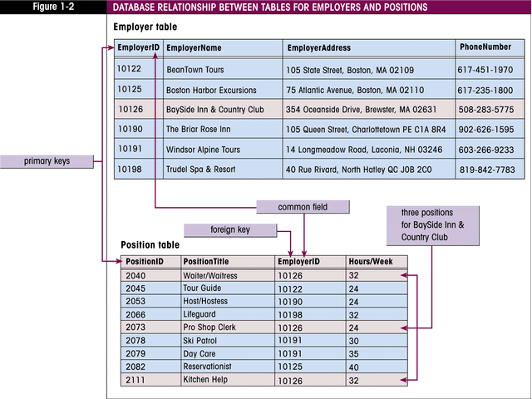
Relating tables using PK and FK
The primary key in the Employer table (EmployerID) is the common field that relates this table to the Position table.
PositionID is the primary key in the Position table. The EmployerID field is a foreign key in this table.
Primary keys can only have one occurrence in a table. Foreign keys may have multiple occurrences.

Slide 13
Class Project I
PAU Procurement Unit has invited you to develop a database system for PAU Talk Shop. The shop sells items such as notebooks, picture frames, flash drives, PAU T-Shirts and snacks. The shop wishes to track the items in the inventory, sales and customer information. You agree to assist in setting up a simple MS Access database that will track the appropriate information.
You identify that three tables should be created:
Product Table containing the product number, product name, product description, product price, and product on hand.
Sale Table containing the sale number, sale date, the product sold and the customer.
Customer Table containing the customer number, customer last name, customer first name, phone number, address and notes about customer preferences

Slide 14
Class Project I
Product Table
Product No. | Name | Description | Price | On-hand
1 | Note book | A small book for writing notes in class | 700 | Yes
2 | Flash Drive | A USB flash drive is a data storage device that includes flash memory with an integrated Universal Serial Bus (USB) interface | 3,200 | Yes
3 | T-Shirt | Customized PAU T-shirts | 7,500 | Yes
4 | Picture Frame | To stand or hang your favorite pictures | 3,500 | Yes

Slide 15
Class Project I
Sale Table
Sale No. | Date | Product No | Customer No
21 | 30/11/21 | 1 | 1011
22 | 30/11/21 | 3 | 1014
23 | 30/11/21 | 3 | 1011
24 | 30/11/21 | 2 | 1013

Slide 16
Class Project I
Customer Table
Customer No. | First Name | Last Name | Phone Number | Address | Notes
1011 | Demola | Adewale | 08092029922 | 2, Ayetobi Strt, Surulere
1012 | Martha | Crown | 08034045931 | 12. Ajayi Crowder Strt, Ajah
1013 | James | Agbolahon | 08023485901 | 43, James Taylor Strt, VI
1014 | Cynthia | Moses | 08059210478 | 90, Gbenga Ayo Strt, Gbariga

Slide 17
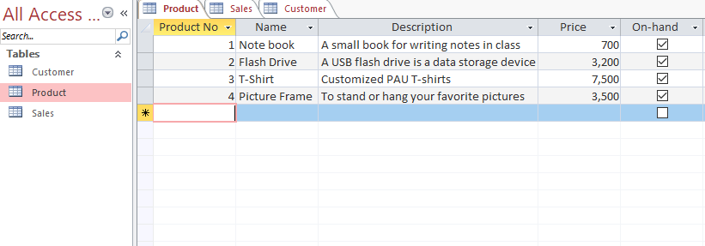
Class Project I
Product Table

Slide 18
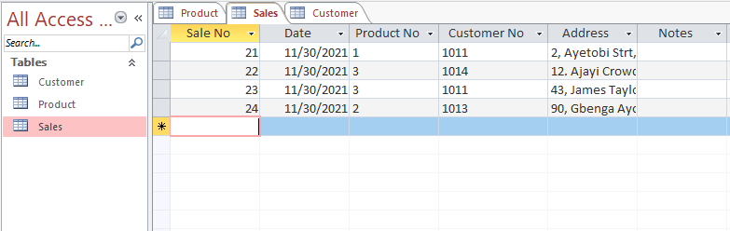
Class Project I
Sales Table

Slide 19
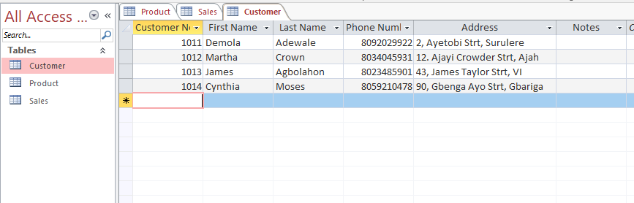
Class Project I
Customer Table

Slide 20
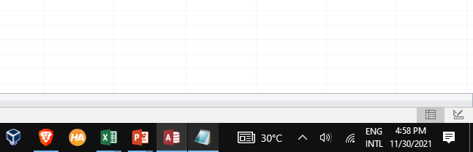
Class Project I
Design View
Datasheet View

Slide 21
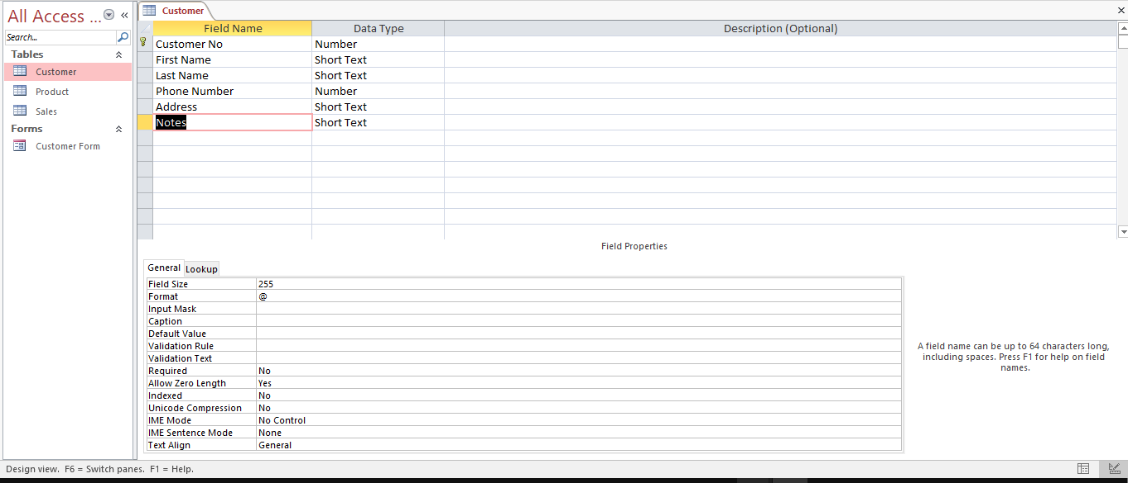
Class Project I

Slide 22
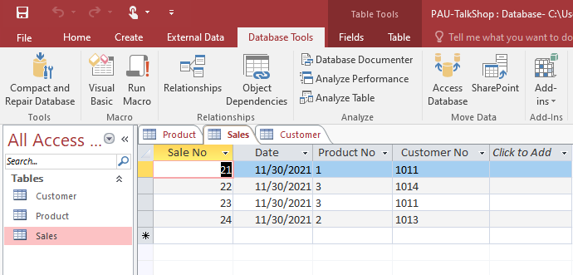
Relationships

Slide 23
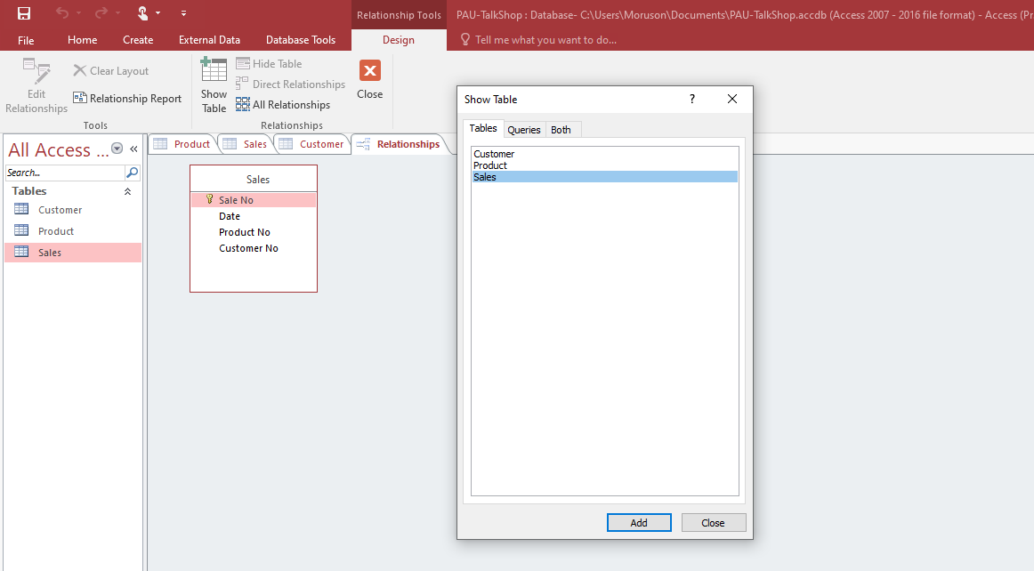
Relationships

Slide 24
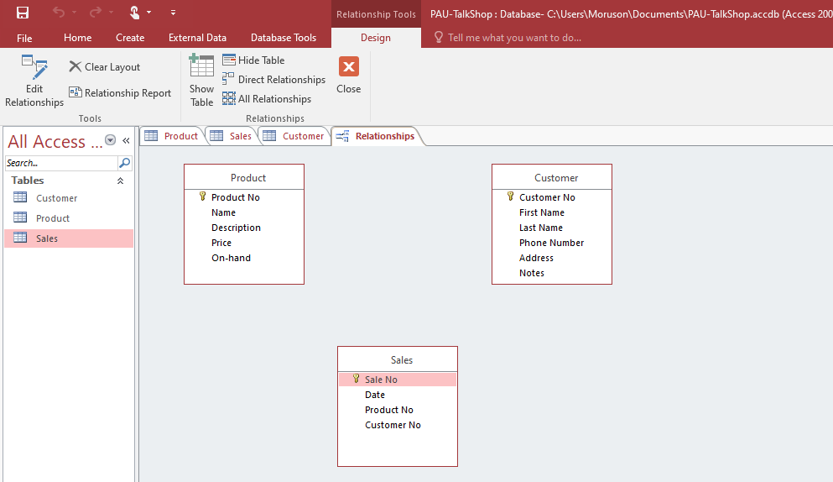
Relationships

Slide 25
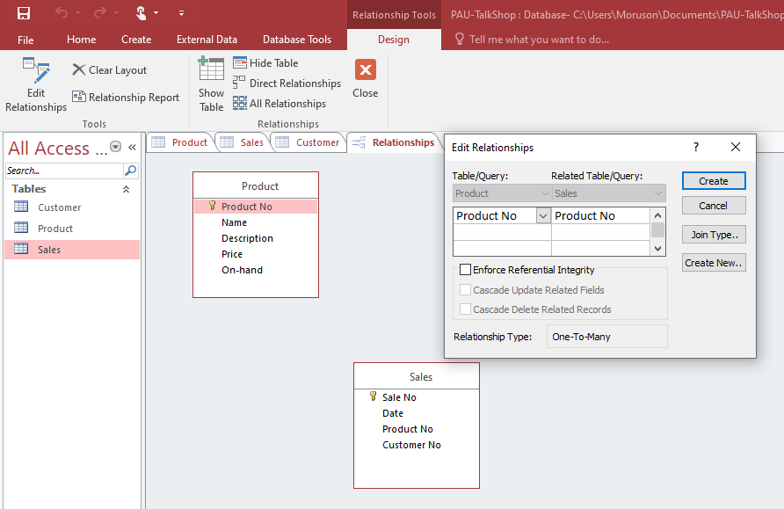
Relationships

Slide 26
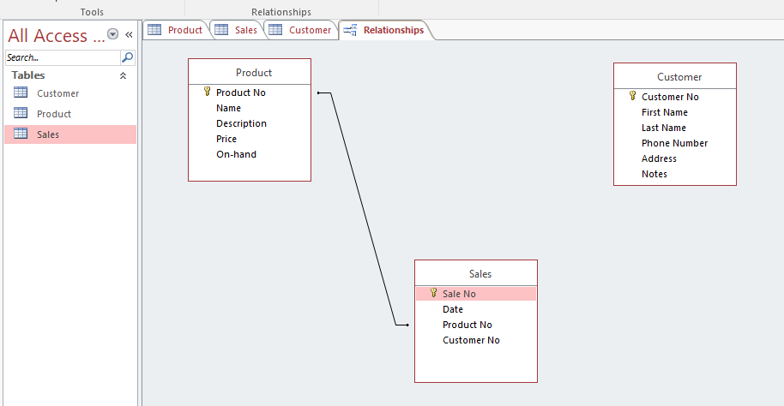
Relationships

Slide 27
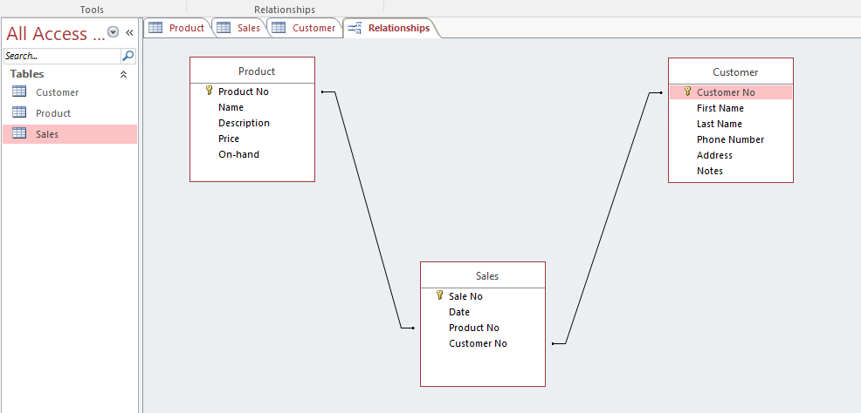
Relationships

Slide 28
A one-to-one relationship
A one-to-one relationship exists when one table has one record associated with only one record of another table.
As we saw from PK as FK database
Sales table is an related table.
Primary table: customer table
Primary key is also foreign key: only Access
A one-to-many relationship exists when one table has one record associated with more than one record of another table.
Sales table has a one-to-many relationship with Customer and Product tables

Slide 29
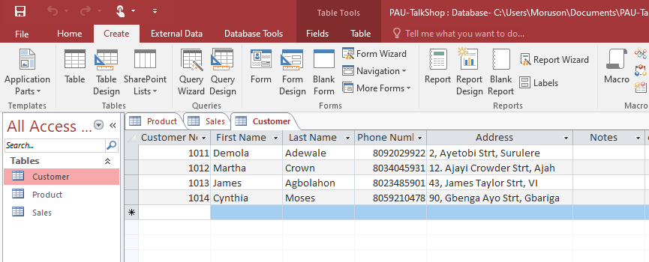
Forms

Slide 30
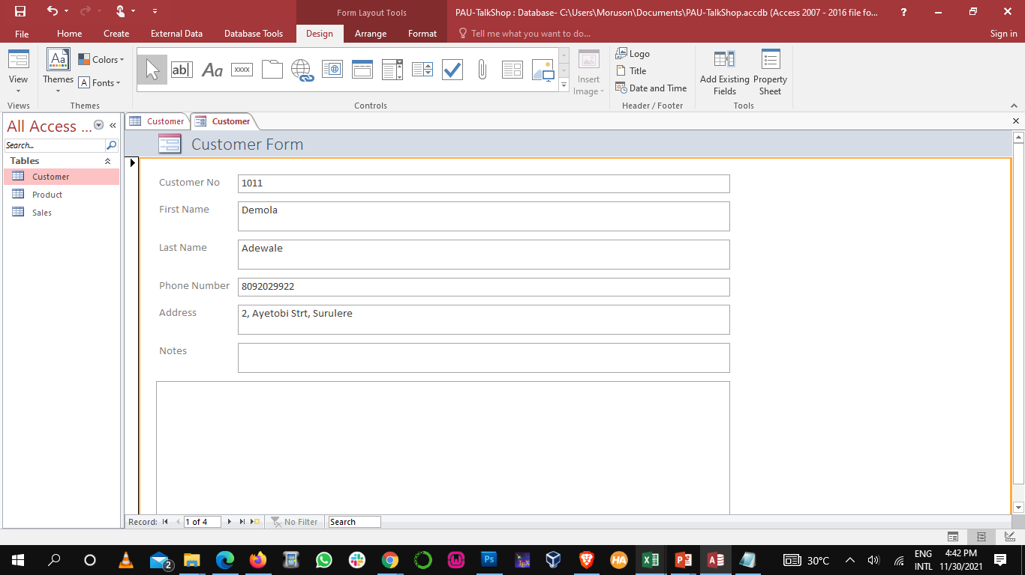
Forms

Slide 31
Forms
Add a blank form

Slide 32
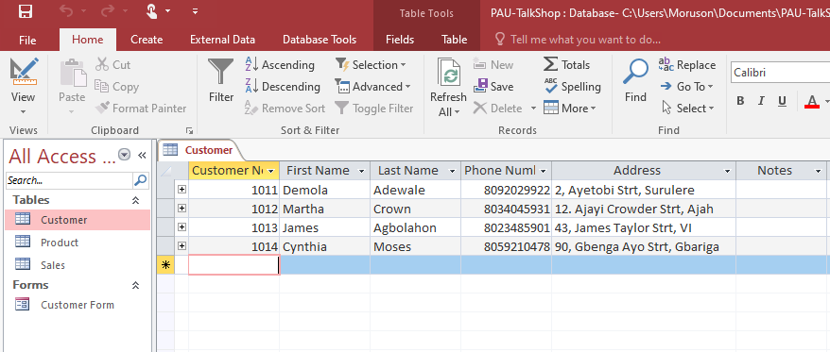
Forms

Slide 33
Class Project II
The Dean of SST has invited you to develop a database management system for the school to manage student results. The database will have three tables:
The Student table containing student id, student name, student level, student phone no., and student email.
The Student result table containing result id, student id, course id, and grade.
The course table containing course id, course code, course title and course description.
Design the database tables, relationships and forms for 10 students, 5 courses and the corresponding results for each student.

